Slide 1
Bank Management System
Presented By Group 5
Charithra S
M Roshini
Manjula B
Rachana V
Tilak Jinachandra Nayak
Varshitha MS
Date: 30/12/2021

Slide 2
Bank Management System
Contents
Introduction
Methodology
System Requirement
Project Modules
Snapshot
Conclusion

Slide 3
Bank Management System
Introduction
A Computer based management system is designed to handle all the primary information in banks.
Bank Management System is an application used to manage the services provided by the bank.
This application helps to reduce the manual work of the bank staffs.
This is a application used by a bank admin to carry out the bank operations.

Slide 4
Bank Management System
Methodology
This Project contains all the basic activities of the bank.
Mainly focused on admin panel.
Admin activities:
Admin can add new users.
can manage all registered users.
Admin can update the user information and delete the user.

Slide 5
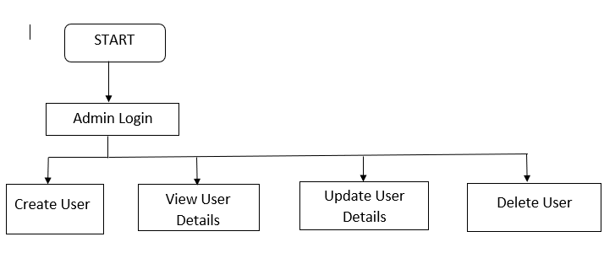
Bank Management System
Block Diagram

Slide 6
Bank Management System
Tools and technologies used
Server-side technologies
Spring Boot - 2.0.5.RELEASE
Spring Framework - 5.0.8 RELEASE
Hibernate - 5.2.17.Final
Spring Data JPA - 2+
MySql
Front end technologies
Angular 9
Bootstrap 4
npm- 6.9.0

Slide 7
Bank Management System
Tools
Maven - 3.2+
IDE - Spring Tool Suite (STS) // Spring boot API development
Visual Studio Code // Angular App development
Angular CLI

Slide 8
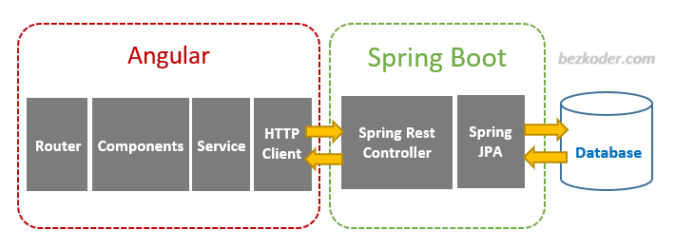
Bank Management System
Angular 11 & Spring Boot CRUD Architecture

Slide 9
Bank Management System
Project Modules
Create User Account
View User Details
Update Details
Delete Details

Slide 10
Bank Management System
Snapshots

Slide 11
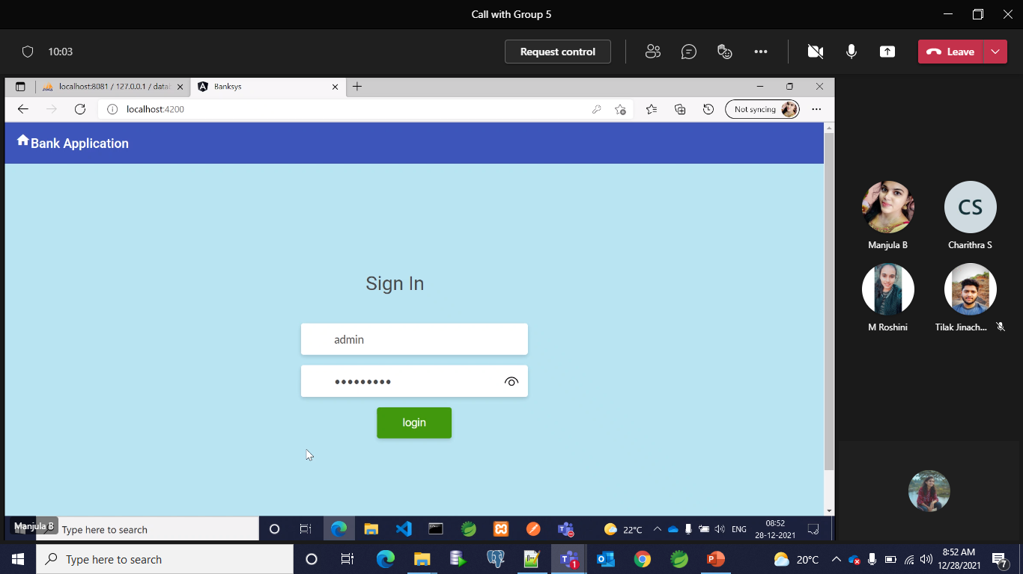
Bank Management System
Login

Slide 12
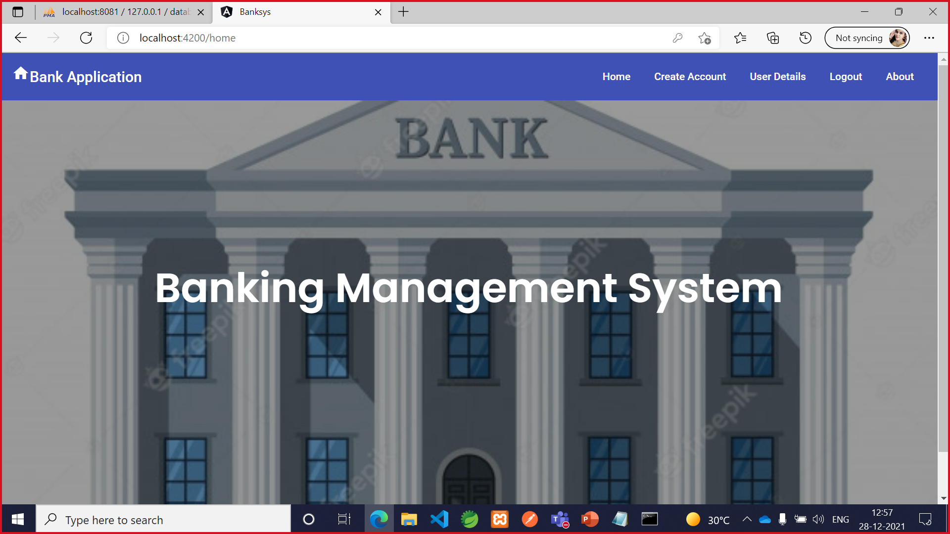
Bank Management System
2. Home Page

Slide 13
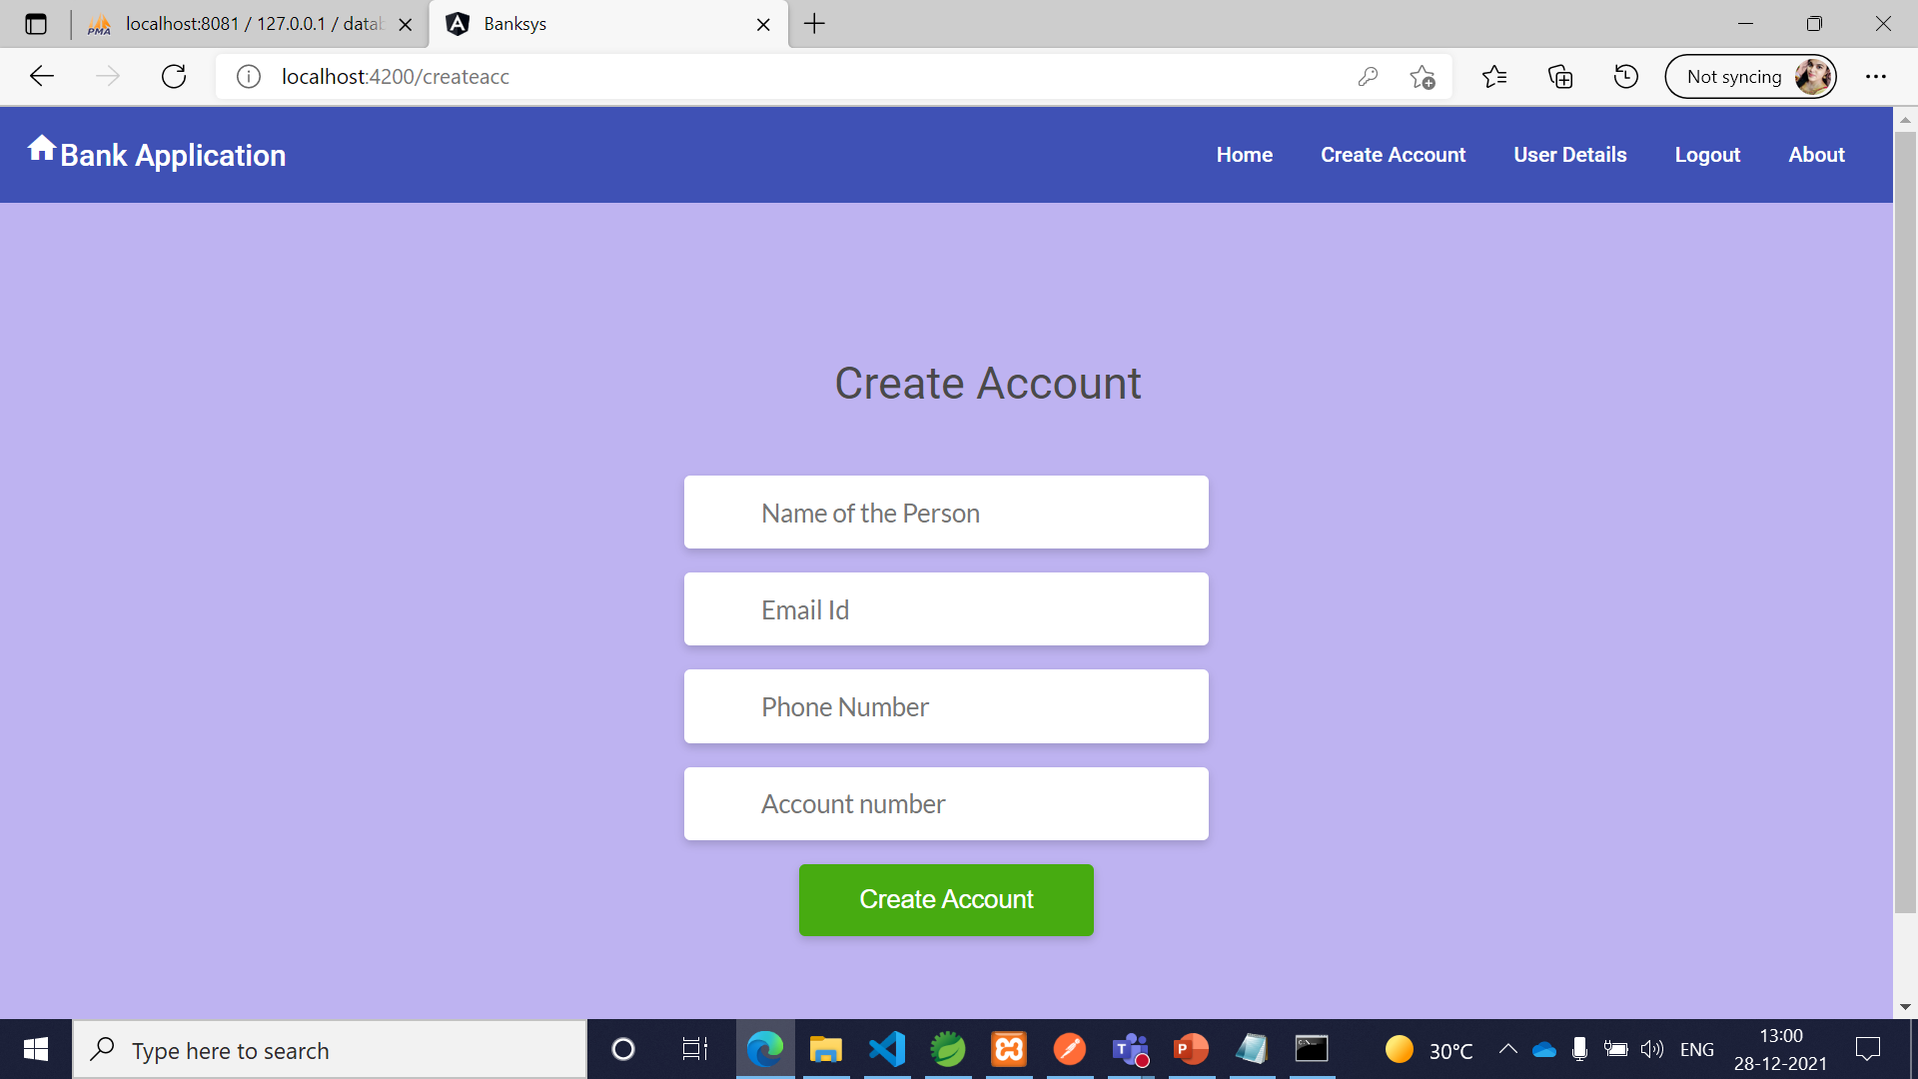
Bank Management System
3. Create Account

Slide 14
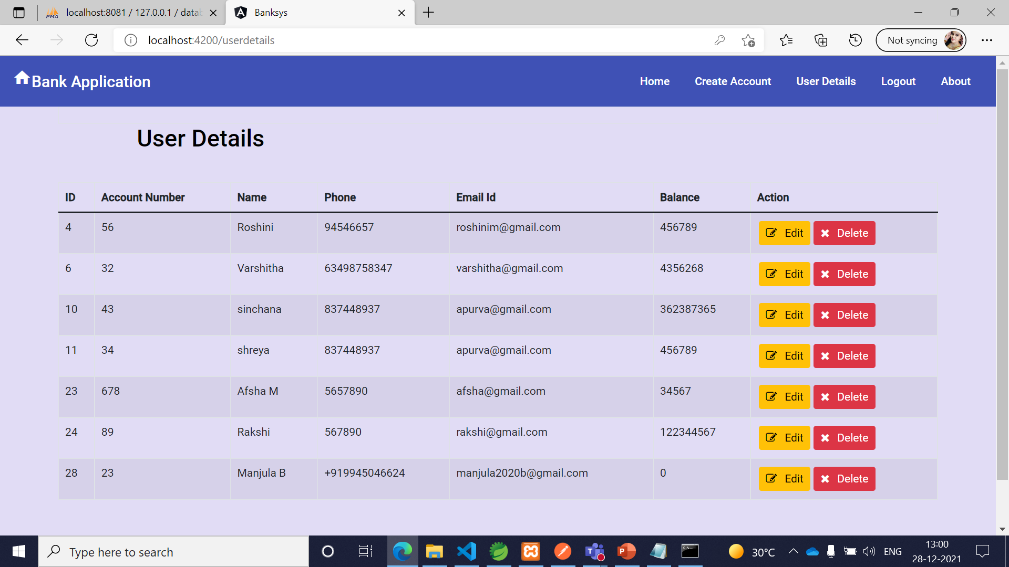
Bank Management System
4. View User Details

Slide 15
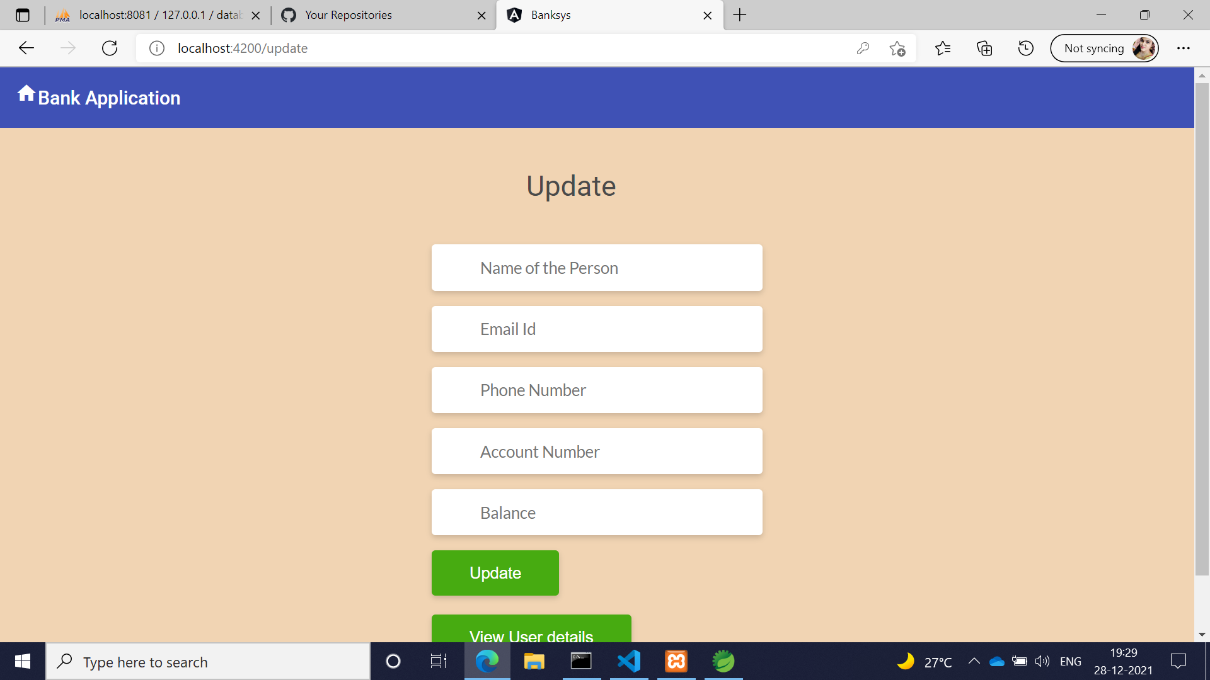
Bank Management System
5. Update

Slide 16
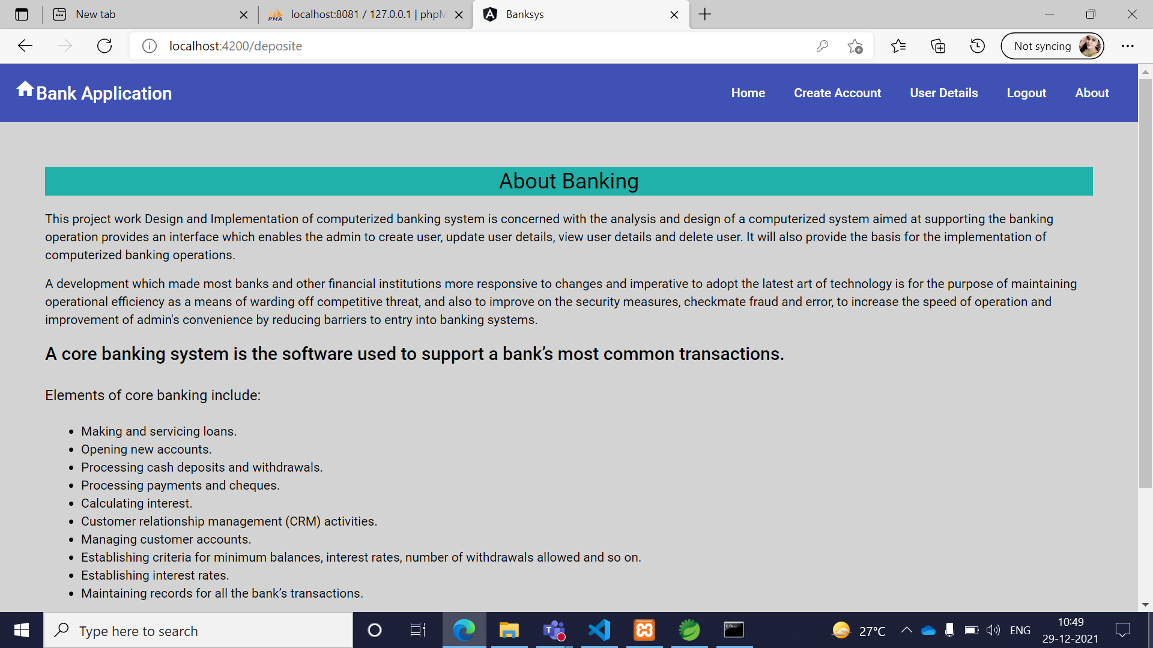
Bank Management System
6. About

Slide 17
Bank Management System
Conclusion
The Banking Management System is more efficient, fast, reliable, user friendly. Over and above the Methodology does not have any possibility of data loss during processing. This banking system project will serve as a useful approach to save the user account data. The maintenance of the records is made efficient, as all the records are stored in the Mysql database, through which data can be retrieved easily. We are providing a monitoring mechanism for admin which is having the ultimate power. And finally the users will be satisfied with our service.

Slide 18
Bank Management System
Thank you

